Slide 1
CS3391 Object Oriented Programming
Dr.D.Sivaganesan, Professor, PSGiTech / CSE
CS3391 Object Oriented Programming Dr.D.Sivaganesan PSGiTech / CSE
1

Slide 2
Input / Output in Java
Java I/O (Input and Output) is used to process the input and produce the output based on the input. The java.io package contains all the classes required for input and output operations. Stream
A stream can be defined as a sequence of data. there are two kinds of Streams
InputStream : The InputStream is used to read data from a source. OutputStream : the OutputStream is used for writing data to a destination. Byte Streams
Java byte streams are used to perform input and output of 8-bit bytes
FileInputStream , FileOutputStream.
Character Streams
Java Character streams are used to perform input and output for 16-bit unicode.
FileReader , FileWriter
Standard Streams
Standard Input: This is used to feed the data to user's program and usually a keyboard is used as standard input stream and represented as System.in.
Standard Output: This is used to output the data produced by the user's program and usually a computer screen is used to standard output stream and represented as System.out. Standard Error: This is used to output the error data produced by the user's program and usually a computer screen is used to standard error stream and represented as System.err.
CS8392 Object Oriented Programming
Dr.D.Sivaganesan and N.Arvaindhraj PSGiTech / CSE
8

Slide 3
Input and Output stream – Console
There are 4 ways i/o streams through console
Using Scanner
Using DataInputStream
Using BufferredReader
Using Console
Syntax :
Scanner obj=new Scanner(System.in);
DataInputStream obj=new DataInputStream(System.in);
BufferredReader obj= new BufferredReader(new InputStreamReader(System.in)
Console obj = System.console()
CS8392 Object Oriented Programming
Dr.D.Sivaganesan and N.Aravindhraj PSGiTech / CSE
11

Slide 4
Input / Output in JAVA
Java I/O (Input and Output) is used to process the input and
produce the output based on the input. Java uses the concept
of stream to make I/O operation fast.
The java.io package contains all the classes required for input
and output operations.
Scanner class
Using Scanner to read text data from keyboard
Use of Scanner is a more convenient and preferred approach for reading text data from keyboard.
Package : import java.util.Scanner;
DataInputStream
Reading text data from keyboard using DataInputStream
DataInputStream is a FilterInputStream that read primitive data from an underlying input stream in a machine-independent way.
Package : import java.io.*;

Slide 5
Scanner Class
Syntax :
Scanner obj=new Scanner(System.in);
Reading int value
int a=s.nextInt();
Reading float value
float b=s.nextFloat();
Reading double
double d=s.nextDouble();
Redaing a string
String str=s.next();
Reading a char
char c=s.next().charAt(0);

Slide 6
import java.util.*;
class input
{ public static void main(String args[])
{ int a; float b;double d; String str;char c;
Scanner s=new Scanner(System.in);
System.out.println("Enter Int value");
a=s.nextInt();
System.out.println("Int value :"+a);
System.out.println("Enter float value");
b=s.nextFloat();
System.out.println("Float value :"+b);
System.out.println("Enter double value");
d=s.nextDouble();
System.out.println("Double value :"+d);
System.out.println("Enter String");
str=s.next();
System.out.println("String :"+str);
System.out.println("Enter a char value");
c=s.next().charAt(0);
System.out.println("Char :"+c);
}}

Slide 7
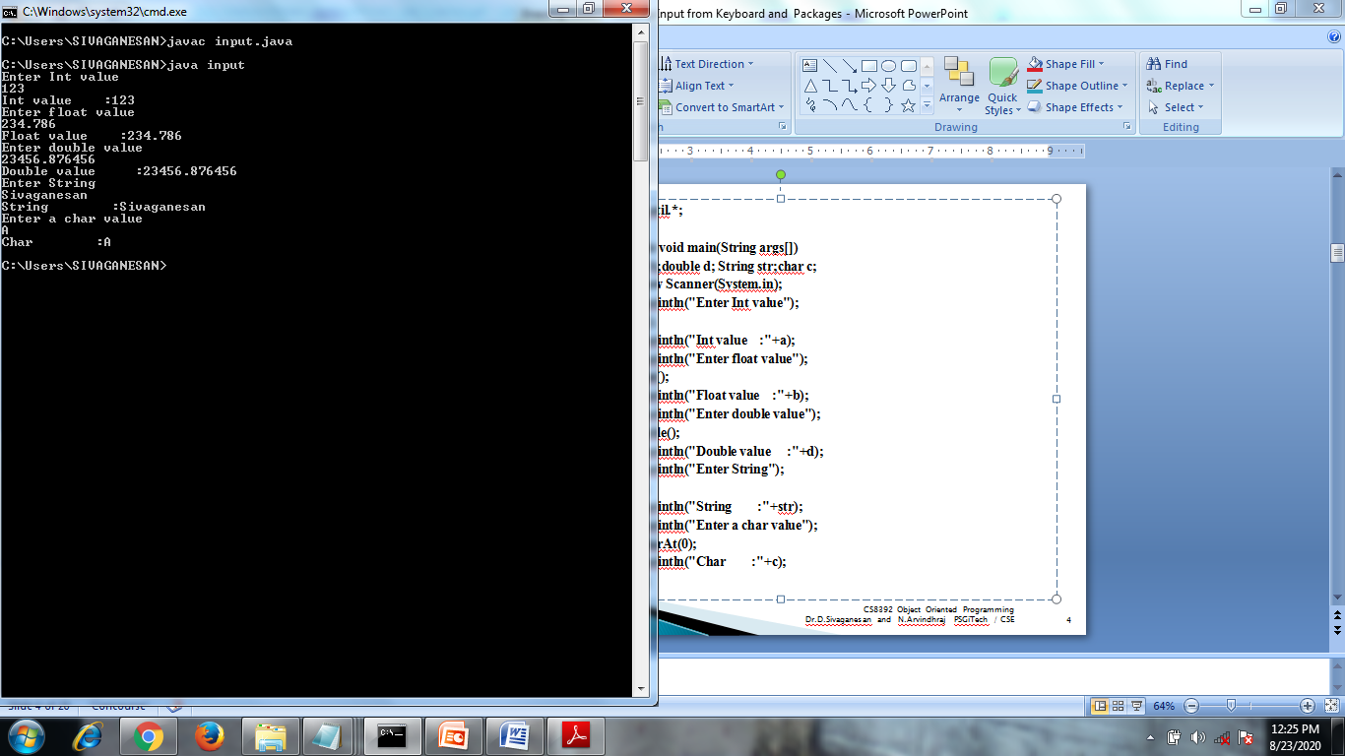

Slide 8
DataInputStream
Syntax :
DataInputStream obj=new DataInputStream(System.in);
Reading int value
int a=Integer.parseInt(s.readLine());
Redaing float value
float b=Float.parseFloat(s.readLine());
Redaing double value
double d=Double.parseDouble(s.readLine());
Reading string
String str=s.readLine();
Reading a char
char c=(char)s.read();

Slide 9
import java.io.*;
import java.io.IOException;
class datainput
{ public static void main(String args[]) throws IOException
{ int a;float b;double d;String str;char c;
DataInputStream s=new DataInputStream(System.in);
System.out.println("enter int value");
a=Integer.parseInt(s.readLine());
System.out.println(" int value :"+a);
System.out.println("enter float value");
b=Float.parseFloat(s.readLine());
System.out.println("enter float value :"+b);
System.out.println("enter double value");
d=Double.parseDouble(s.readLine());
System.out.println("double value :"+d);
System.out.println("enter string");
str=s.readLine();
System.out.println("string :"+str);
System.out.println("enter char");
c=(char)s.read();
System.out.println("char :"+c);
}}

Slide 10
import java.io.*;
import java.io.IOException;
class bufferreader
{ public static void main(String args[]) throws IOException
{ int a; float b; double d; String str; char c;
BufferedReader s=new BufferedReader(new InputStreamReader(System.in)); System.out.println("enter int value");
a=Integer.parseInt(s.readLine()); System.out.println(" int value :"+a);
System.out.println("enter float value"); b=Float.parseFloat(s.readLine()); System.out.println("enter float value
:"+b);
System.out.println("enter double value"); d=Double.parseDouble(s.readLine()); System.out.println("double value :"+d); System.out.println("enter string"); str=s.readLine(); System.out.println("string :"+str); System.out.println("enter char"); c=(char)s.read();
System.out.println("char :"+c);}}
CS8392 Object Oriented Programming
Dr.D.Sivaganesan and N.Aravindhraj PSGiTech / CSE
12

Slide 11
import java.io.*;
import java.io.IOException;
class exconsole
{ public static void main(String args[]) throws IOException
{ int a; float b; double d; String str; char c;
Console s=System.console(); System.out.println("enter int value");
a=Integer.parseInt(s.readLine()); System.out.println(" int value :"+a);
System.out.println("enter float value"); b=Float.parseFloat(s.readLine()); System.out.println("enter float value
:"+b);
System.out.println("enter double value"); d=Double.parseDouble(s.readLine()); System.out.println("double value :"+d); System.out.println("enter string"); str=s.readLine(); System.out.println("string :"+str); System.out.println("enter char"); c=s.readLine().toCharArray()[0];;
System.out.println("char :"+c);}}
CS8392 Object Oriented Programming
Dr.D.Sivaganesan and N.Aravindhraj PSGiTech / CSE
13

Slide 12
ByteStream
This is used to process data byte by byte (8 bits).
FileInputStream and the FileOutputStream are the most popular ones.
The FileInputStream is used to read from the source and
FileOutputStream is used to write to the destination.
STREAM CLASS | DESCRIPTION
BufferedInputStream | It is used for Buffered Input Stream.
DataInputStream | It contains method for reading java standard datatypes.
FileInputStream | This is used to reads from a file
InputStream | This is an abstract class that describes stream input.
PrintStream | This contains the most used print() and println() method
BufferedOutputStream | This is used for Buffered Output Stream.
DataOutputStream | This contains method for writing java standard data types.
FileOutputStream | This is used to write to a file.
OutputStream | This is an abstract class that describe stream output.
CS8392 Object Oriented Programming
Dr.D.Sivaganesan and N.Aravindhraj PSGiTech / CSE
9

Slide 13
CharacterStream:
Character streams are used to perform input and output for 16-bit unicode.
Character stream automatically allows us to read/write data character by character.
FileReader and the FileWriter are the most popular ones.
FileReader and FileWriter are character streams used to read from the source and write to the destination respectively.
STREAM CLASS | DESCRIPTION
BufferedReader | It is used to handle buffered input stream.
FileReader | This is an input stream that reads from file.
InputStreamReader | This input stream is used to translate byte to character.
OutputStreamReader | This output stream is used to translate character to byte.
Reader | This is an abstract class that define character stream input.
PrintWriter | This contains the most used print() and println() method
Writer | This is an abstract class that define character stream output.
BufferedWriter | This is used to handle buffered output stream.
FileWriter | This is used to output stream that writes to file.
CS8392 Object Oriented Programming
Dr.D.Sivaganesan and N.Aravindhraj PSGiTech / CSE
10

Slide 14

CS8392 Object Oriented Programming
Dr.D.Sivaganesan and N.Arvindhraj PSGiTech / CSE
14

